Slide 1
Paytm application for online transaction
Project By : K BHARATH KUMAR
Reg No :192111176
Dept : CSE

Slide 2
Project details
objective
abstract
proposed system
flow chart
concept map
test cases
application tools
implementation
test case outcome
conclusion

Slide 3
objective
The main use of this is to transfer money online within seconds which is also 100% safe and secure.

Slide 4
abstract
This app helps in money transaction.
In this app we transfer money in seconds.
And it is 100% secure.
We have many other features in this app like mutual funds, insurance,
Loans, etc.

Slide 5
PROPOSED SYSTEM
using appium to test this app
we need to need to install intelij idea to create an project and make operations to clone version of app
then we use the test cases one-by-one and conclude the results to the test cases
after testing we suggest the conclusion that some additional idea implementation in the app

Slide 6
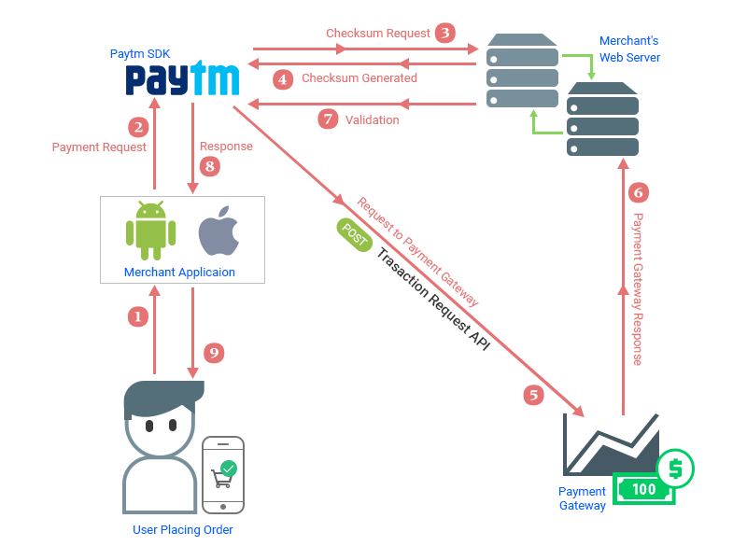
Flow chart

Slide 7
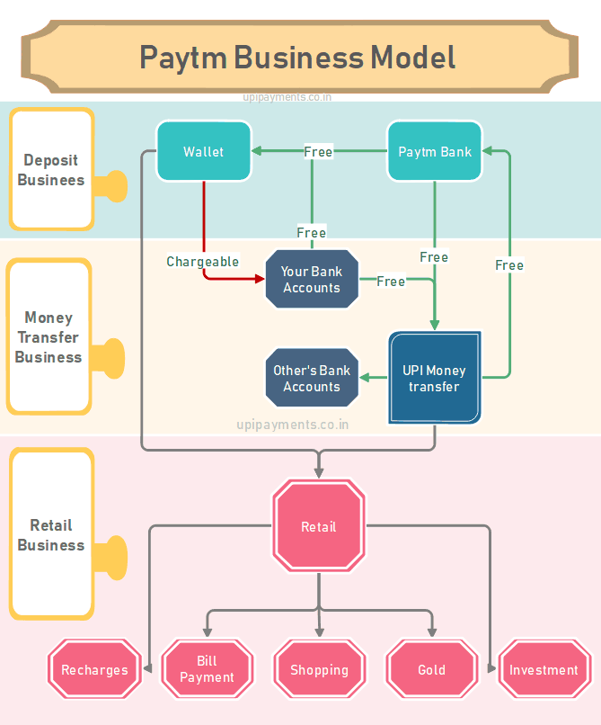
Concept mapping

Slide 8
Test cases
Sign up.
Login / Logout.
Collect transaction information.
Create an order.
Choose paytm mode and fill details.
Fill the two factor authentication(otp,iPIN ATM PIN).
Verifies order value and transaction status.
Display order conformation message.

Slide 9



Application tools

Slide 10
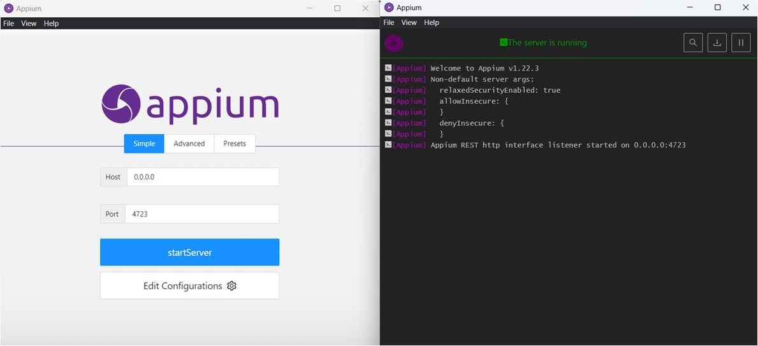
Appium server

Slide 11
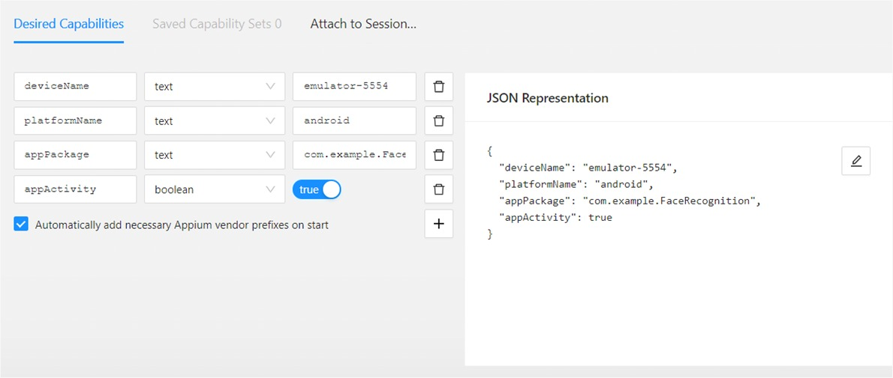
Appium server inspector

Slide 12
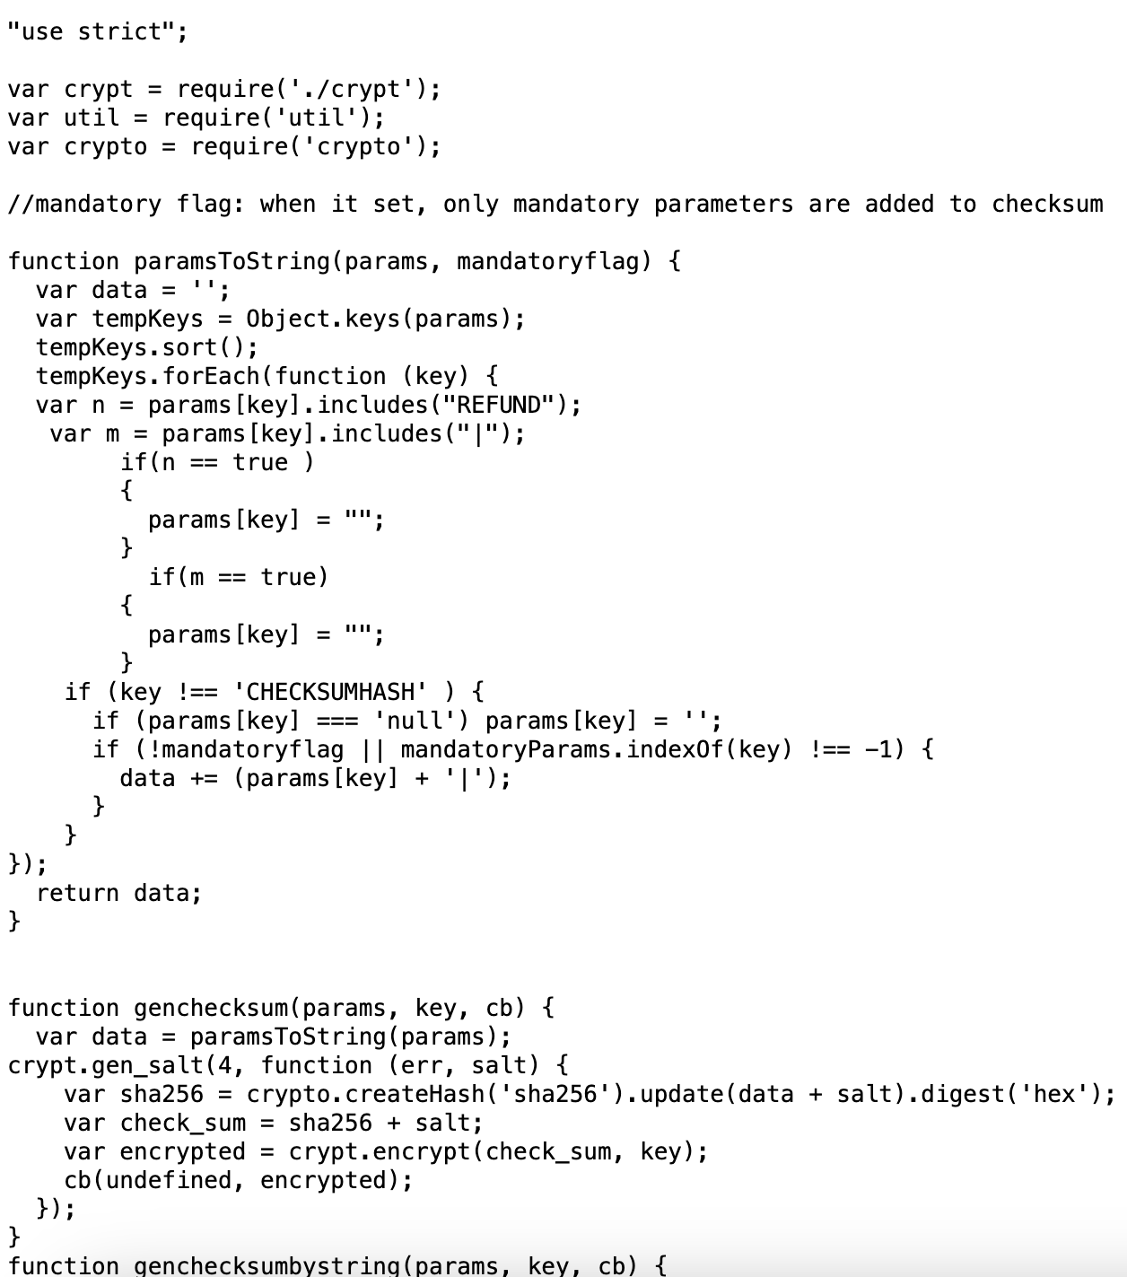
code

Slide 13
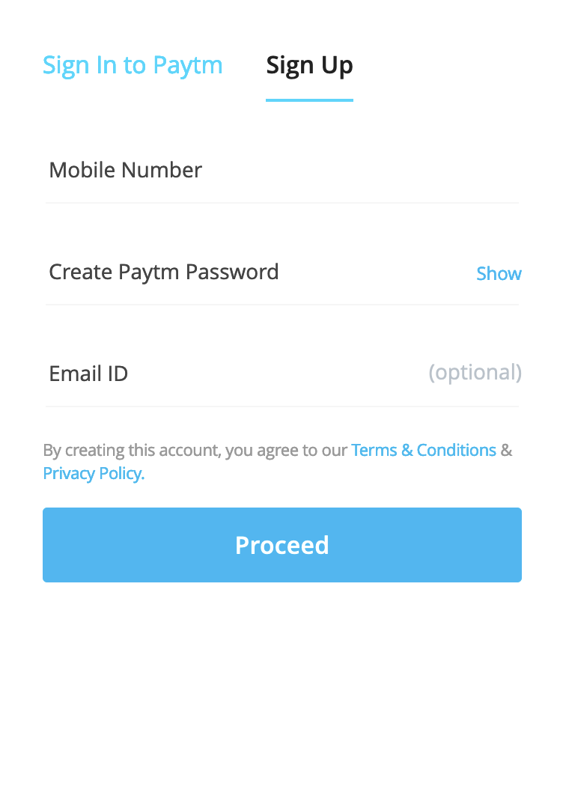
Installation

Slide 14
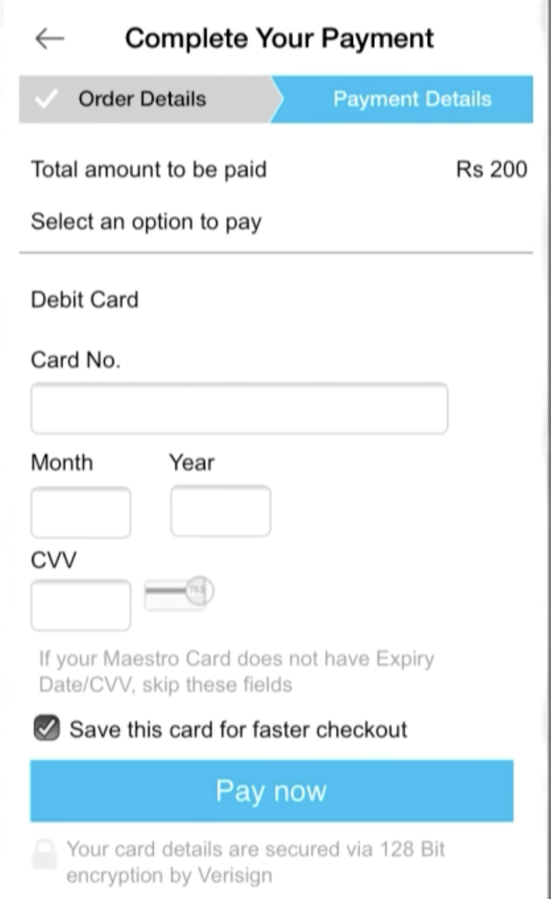
Test case

Slide 15
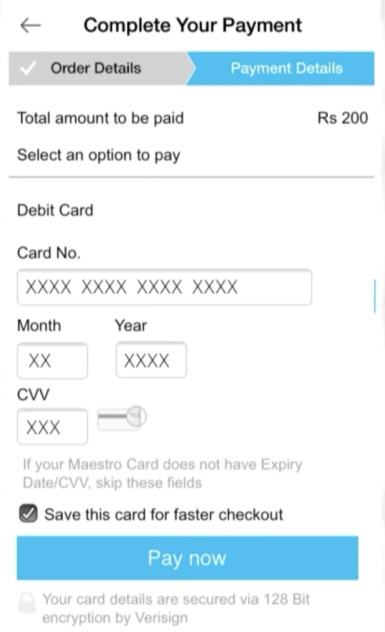
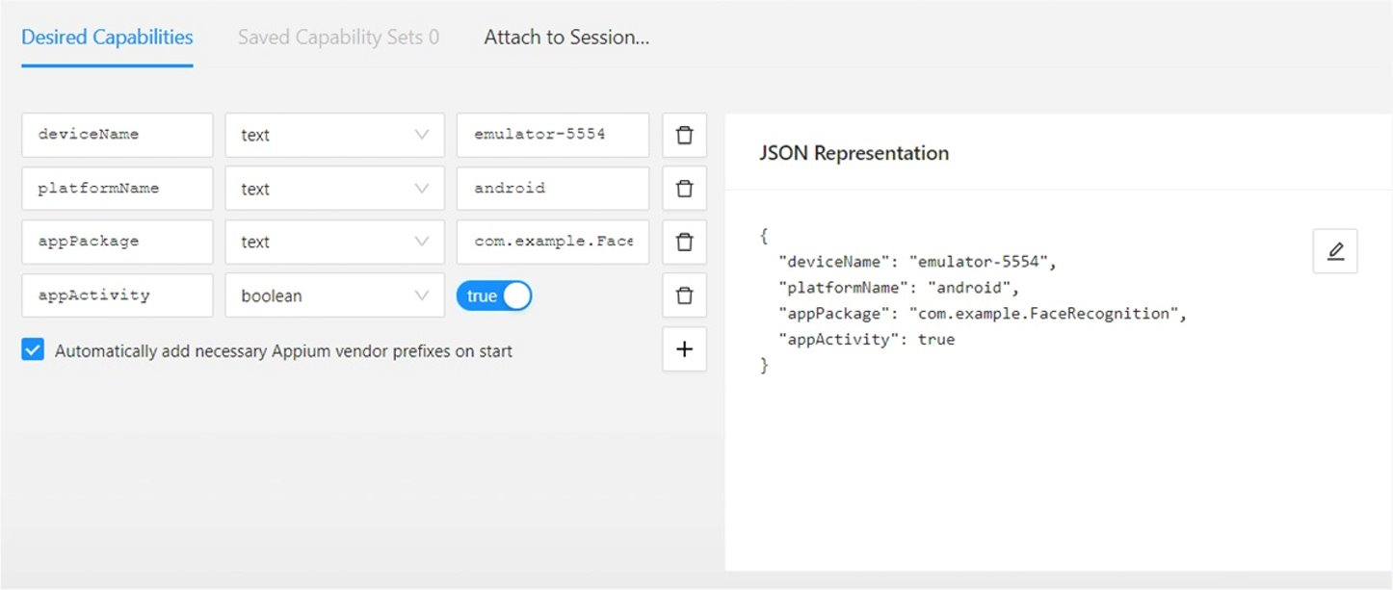
Testing output

Slide 16
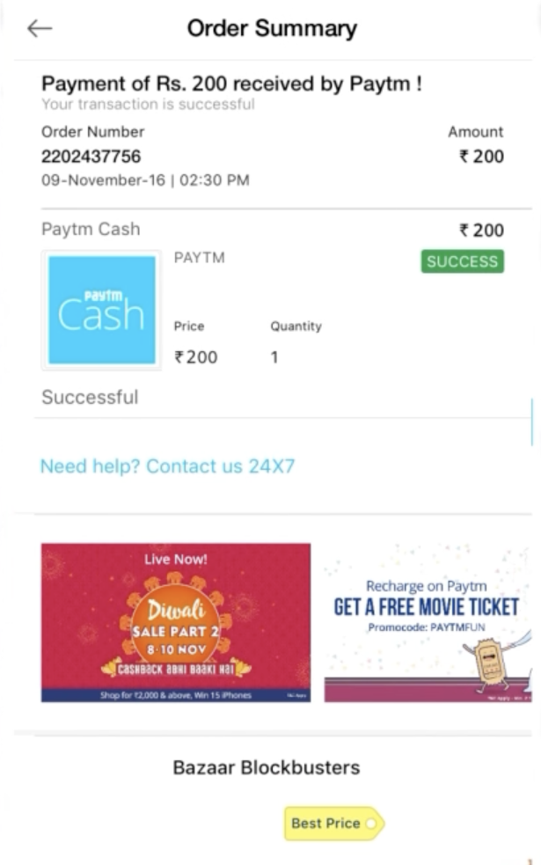
Test output

Slide 17
Test case out comes
Test case
 | Outcome
Verify the user able to login with valid user name and password. | Postive
Verify if user is not able to login with valid username and invalid password. | Negative
Verify the forget password functionality. | Postive
Verify the message for invalid login. | Postive
Verify the user is able to do payments. | Postive
Verify the user is able to see the payment status. | Postive

Slide 18
conclusion
Internet transaction is very convenient. It allows us to pay and shop anywhere, check the balance of our cards, check our shopping history and show what we want to see. However, Internet transaction can be very dangerous too. We might be deceived. Therefore, we should use Internet transactions safely and properly.

